Slide 1
What is the best model to score the sentiment of movie reviews?
By Noel Mathew

Slide 2
Problem to Answer
Every time a movie comes out, there is always somebody reviewing it. Sometimes the movie could get great reviews. In other cases, the movie could be a flop and get bad reviews.
This project goal is to evaluate what type of model can predict a good review or a bad review the best.
In addition, this project will check if any of these words can show if a review is good or bad.

Slide 3
Who is my client
Review Sites Like Rotten Tomatoes
They can auto score reviews from many different sources from many sites and put them on their site
Movie Executives/Producers
Can find which movies had good reviews and bad reviews without hiring other resources to figure out which movies to make sequels of.
Actors/Directors
Can figure out which movies they performed well in.

Slide 4
Data that will be used
Movies reviews from IMDB
Movie ID
Review of the Movie
Sentiment Analysis score (0) for negative (1) for positive.
Data set that will be used
https://www.kaggle.com/c/word2vec-nlp-tutorial/data

Slide 5
Data Cleaning Steps
Get rid of non word text in the review
Remove HTML encodings using Beautiful Soup
Use an regex expression to get rid of non-words text
Split the review to separate words and lower case them
Remove any stop words
Add a clean review column in the csv file
Run each review through the steps above in the labeled data file
Append each clean review to a list
Make new clean review column and use the items in the list above as the values
Convert the Dataframe into a csv file with the new clean review file.

Slide 6
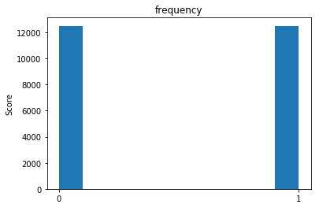
Data Story: Reviews and Scores
The positive and negative scores are evenly distributed

Slide 7
Data Story: Words affect scores
The next slides will show words and similar words and how distribution of scores are based on those words

Slide 8
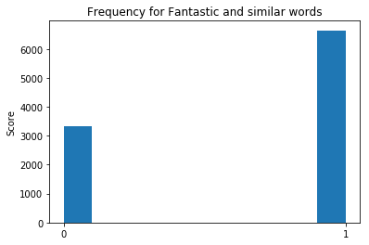

Slide 9
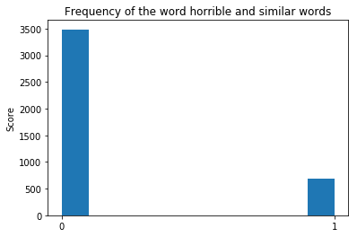

Slide 10
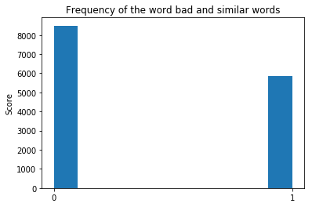

Slide 11
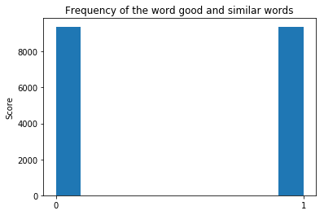

Slide 12
Statistical Analysis
Since these are unique reviews with words or text, it is not possible to do statistical analysis on the features which are the clean reviews.
The labels have a mean of 0.5 as the scores are evenly disburtubed between negative (0) and positive (1).

